Slide 1
MLaaS: Anomaly Detection with ML

Slide 2


Slide 3
MLaaS
Category​ | Al-Powered Solutions
Idea Title | ML as a Service - Anomaly detection for Production Allocation in EC
Team Members​ | Andrei Avram, Oleksandr Lakovliev,, Xin Wang, Shengtong Zhong, Daniel Fonnes and Sarojini Rajaretnam
Problem Description​ | EC provides functionality to setup threshold manually for well data (i.e press, temp and etc) for data validation purpose. This is a manual process, time consuming and errors can go undetected.
Benefit to Quorum or our Customers​ | 1. Reduce time & cost of configuring and maintenance of threshold 2.Improve the accuracy of error detection 3.Integration flexibility with BPM workflows and management-by-exception approach
HaQathon Goal | ML model is available as a service using EC Analytics Manager with dumb-proof connection.

Slide 4
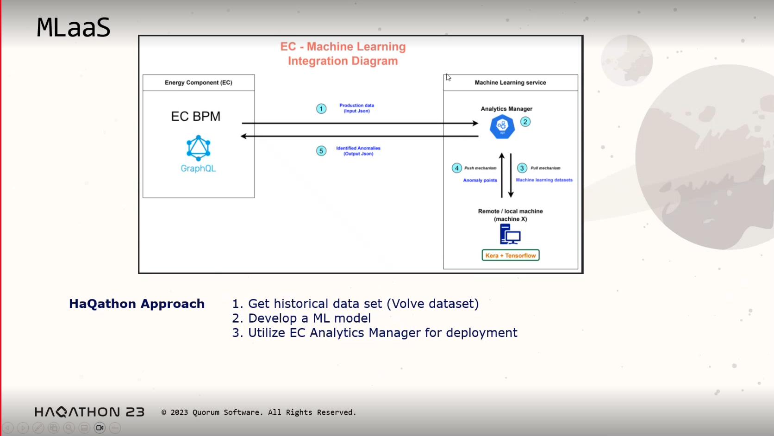

Slide 5
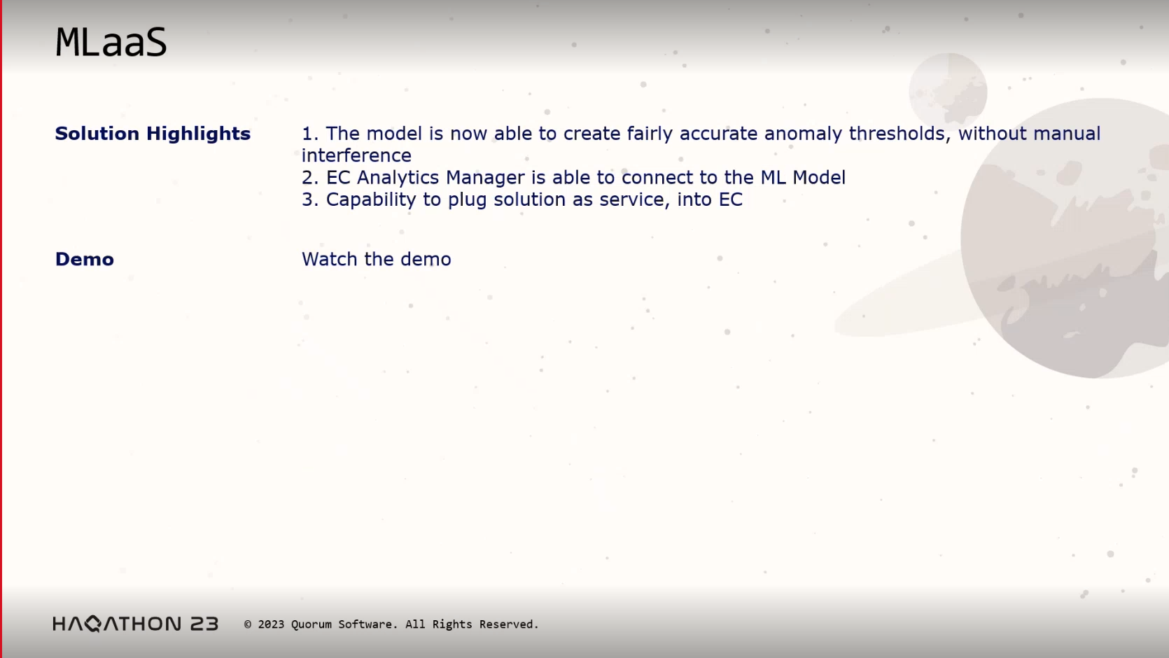

Slide 6
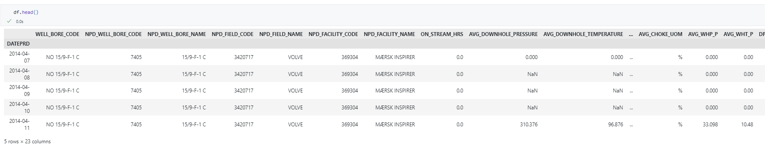
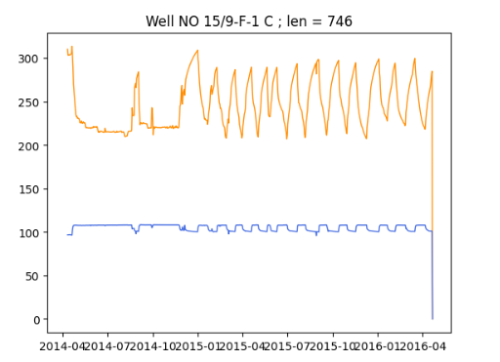
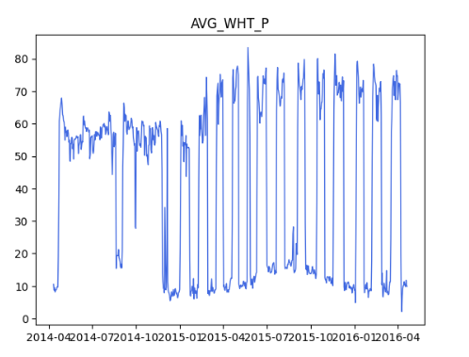

Slide 8
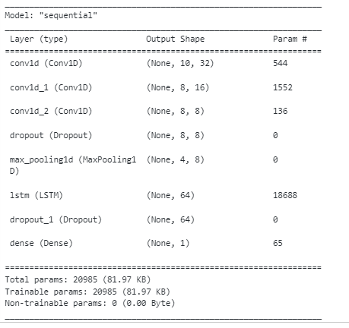

Slide 9
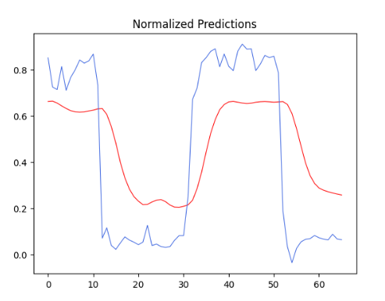
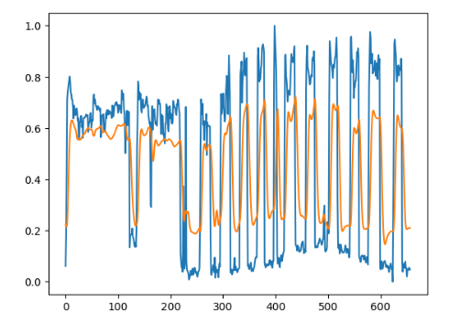

Slide 10
